Slide 1

بِسْمِ اللّٰهِ الرَّحْمٰنِ الرَّحِيْمِ

Slide 2
VCS Introduction of Android

Slide 3
Mobile Computing
Mobile Computing
LECTURE 02
VCS Introduction of Android
Instructor:
Maulana Haq Nawaz

Slide 4
تصحیح نیت
حضرت محمد صلی اللہ علیہ وسلم نے فرمایا
اِنَّمَا الْاَعْمَالُ بِالنِّـیَّاتِ
ترجمہ
اعمال کا دارومدار نیتوں پر ہے

Slide 5
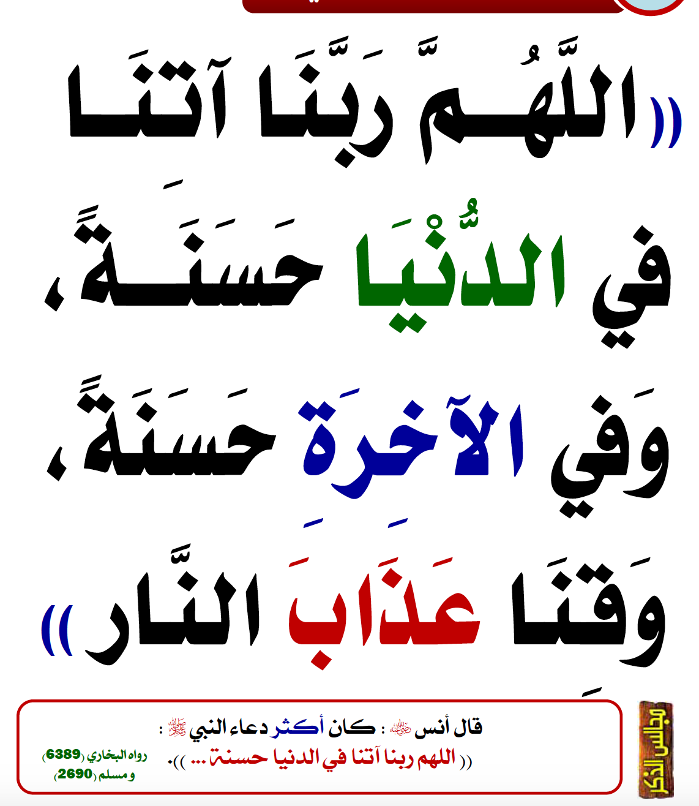
دُعا

Slide 6

دُعا

Slide 7
Course Focus
Life = Technical Skills (15%) + Human Engineering (85%)
To Master the Art of Living, mainly get Excellence in two things
Become a Balanced and Characterful Personality
Become an Authority in Mobile Computing in the whole World

Slide 8

Little Efforts Daily Will Make You the Greatest
Importance of completing tasks on daily basis
Main Reason of Failure in Life
یہ کام کل کریں گے
جو کام کبھی بھی ہو سکتا ہے وہ کبھی نہیں ہوتا
زندگی ایک دن ہے اور وہ ہے آج۔ زندگی میں کل نام کی کوئی چیز نہیں ہے
جو دن آپ کی زندگی سے چلا گیا اب واپس نہیں آئے گا
آج کا کام آج ہی ہوسکتا ہے
جو گز گیا وہ آنا نہیں ، آنے والے دن کا پتہ نہیں ، آج میدان جما ہے تو اپنے جوہر دکھاؤ

Slide 9
How to Achieve BIG Goals in Life
Balanced Life is Ideal Life 😊
To achieve BIG Goals in Life
Make a Schedule of 24 Hours with a focus on Five main components of Human Life
Health
Physical Health
Mental Health
Social Health
Spirituality
Work
Family
Friends

Slide 10



جو کام کریں دل سے کریں
کام کرنا.
خوشی خوشی کام کرنا.
الله کو ساتھ لے کرخوشی خوشی کام کرنا.
آیت: إِيَّاكَ نَعْبُدُ وإِيَّاكَ نَسْتَعِينُ
ترجمہ: یا الله ہم تیری ہی عبادت کرتے ہیں.
اور تجھ ہی سے مد د مانگتے ہیں

Slide 11
Lecture Outline
1
Best Teaching and Learning Methodology of the World
2
Learn Duas
3
Learn about Version Control System and Android
4
Git Pull
5
Git Log
6
Git online editing
7
Git Branching
8
Git Merge
9
Git Delete
10
,, delete
11
Stop Complaining! Stop Criticizing! Let’s Start Contributing
12
Lecture Summary

Slide 12

Mobile Computing
VCS-git
Keep track of changes to code
int a= 0;
Created a File
string name= “Musa”;
int a= 0, b=1;
Added Code
string name= “Musa”;

Slide 13
Mobile Computing
VCS-git
Keep track of changes to code
int a= 23, b=1;
Modified Code
string name= “Musa”;
int a= 23; b=1
Deleted Code
string name= “Musa”;

Slide 14
Mobile Computing
VCS-git
Keep track of changes to code
int a= 0;
int a= 23, b=1;
string name= “Musa”;
string name= “Musa”;
int a= 0, b=1;
int a= 23; b=1
string name= “Musa”;
string name= “Musa”;

Slide 15

Mobile Computing
Code Synchronizing
Code Synchronizing between different groups
Central Repository
Asad’s Repository
Fatima’s Repository
Zahid’s Repository

Slide 16
Mobile Computing
Code Synchronizing
Same code available to all members
int a = 1;
Central Repository
int a = 1;
int a = 1;
int a = 1;
Asad’s Repository
Fatima’s Repository
Zahid’s Repository

Slide 17
Mobile Computing
Code Synchronizing
Different people working on different files
int a = 1;
Central Repository
int a = 1;
int b = 2;
int a = 1;
int c = 3;
int a = 1;
int d = 4;
Asad’s Repository
Fatima’s Repository
Zahid’s Repository

Slide 18
Mobile Computing
Code Synchronizing
Different people working on different files
int a = 1;
int b = 2;
int c = 3;
int d = 4;
Central Repository
int a = 1;
int b = 2;
int a = 1;
int c = 3;
int a = 1;
int d = 4;
Asad’s Repository
Fatima’s Repository
Zahid’s Repository

Slide 19
Mobile Computing
Code Synchronizing
Different people working on different files
int a = 1;
int b = 2;
int c = 3;
int d = 4;
Central Repository
int a = 1;
int b = 2;
int c = 3;
int d = 4;
int a = 1;
int b = 2;
int c = 3;
int d = 4;
int a = 1;
int b = 2;
int c = 3;
int d = 4;
Asad’s Repository
Fatima’s Repository
Zahid’s Repository

Slide 20
Mobile Computing
Code Testing
Test changes without loosing original
code1
code2
code1
code2
code3
code4
code1
code2
code3
code4

Slide 21
Mobile Computing
Revert
Revert back to old versions
code1
code2
code1
code2
code3
code1
code2
code3
code4
code1
code2
code3
code4
code5

Slide 22

Mobile Computing
GitHub Account
Create a Account on github.com

Slide 23
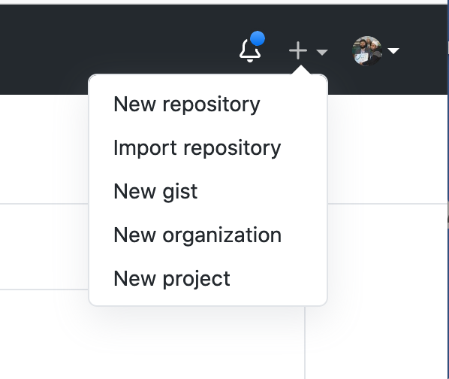
Mobile Computing
GitHub Repository
Create a repository on GitHub

Slide 24
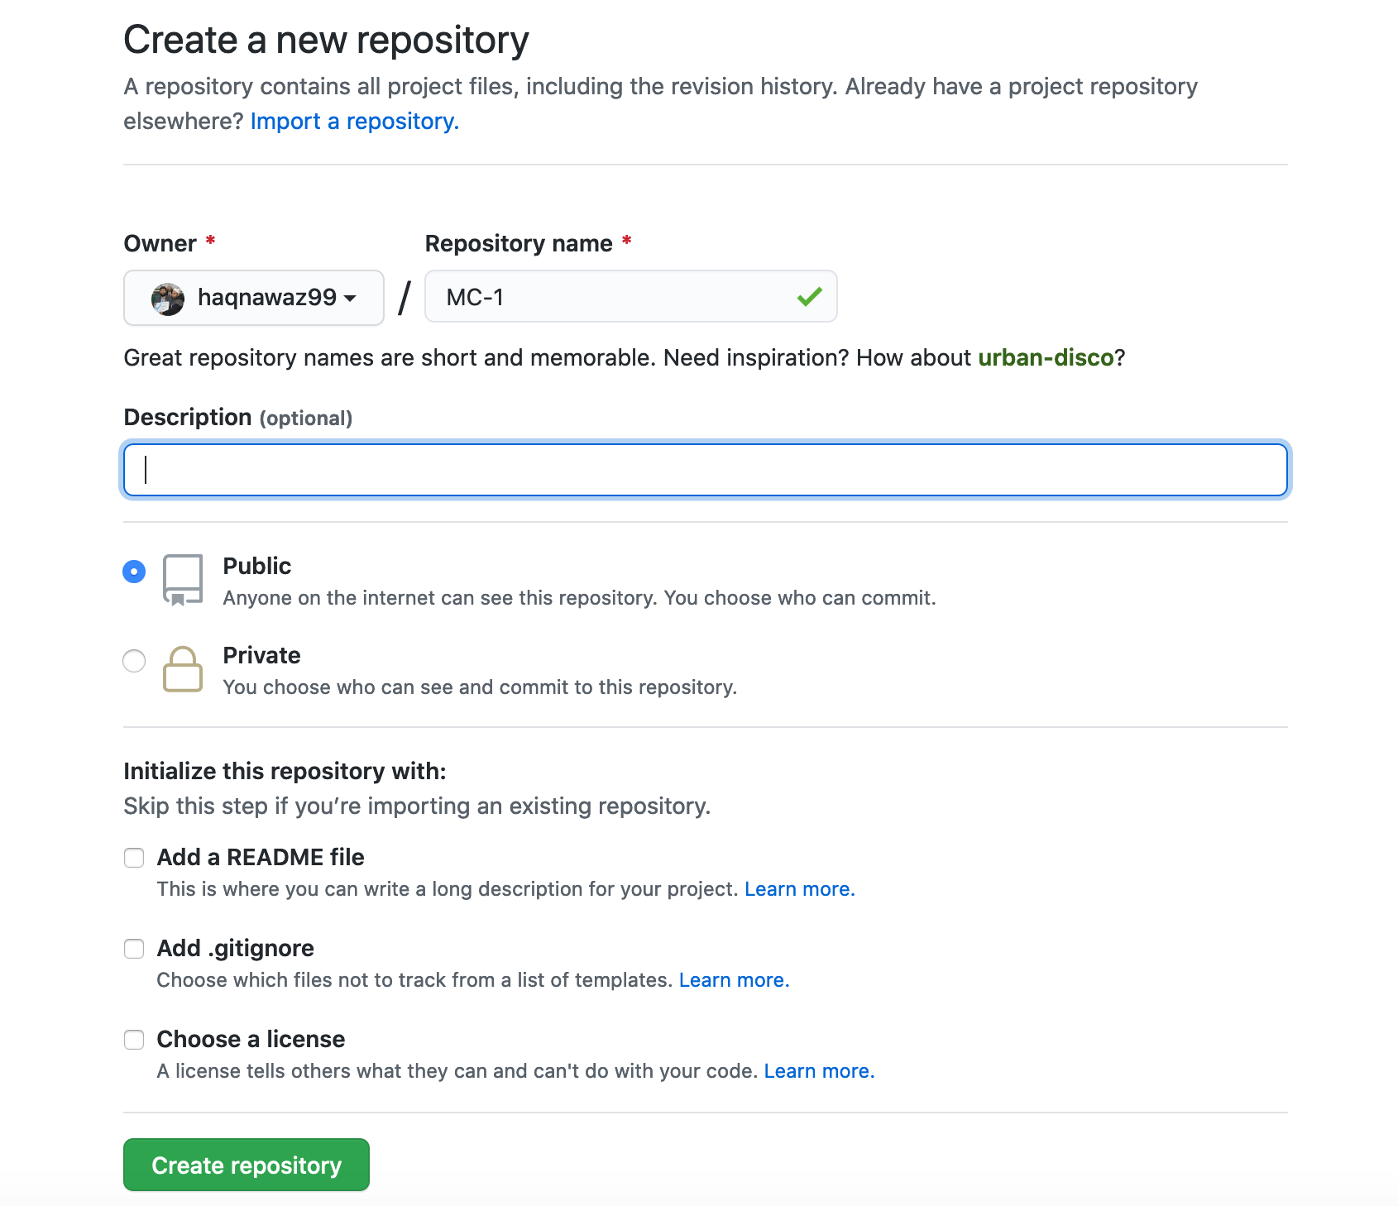
Mobile Computing
GitHub Repository
Provide details of repository on your account

Slide 25
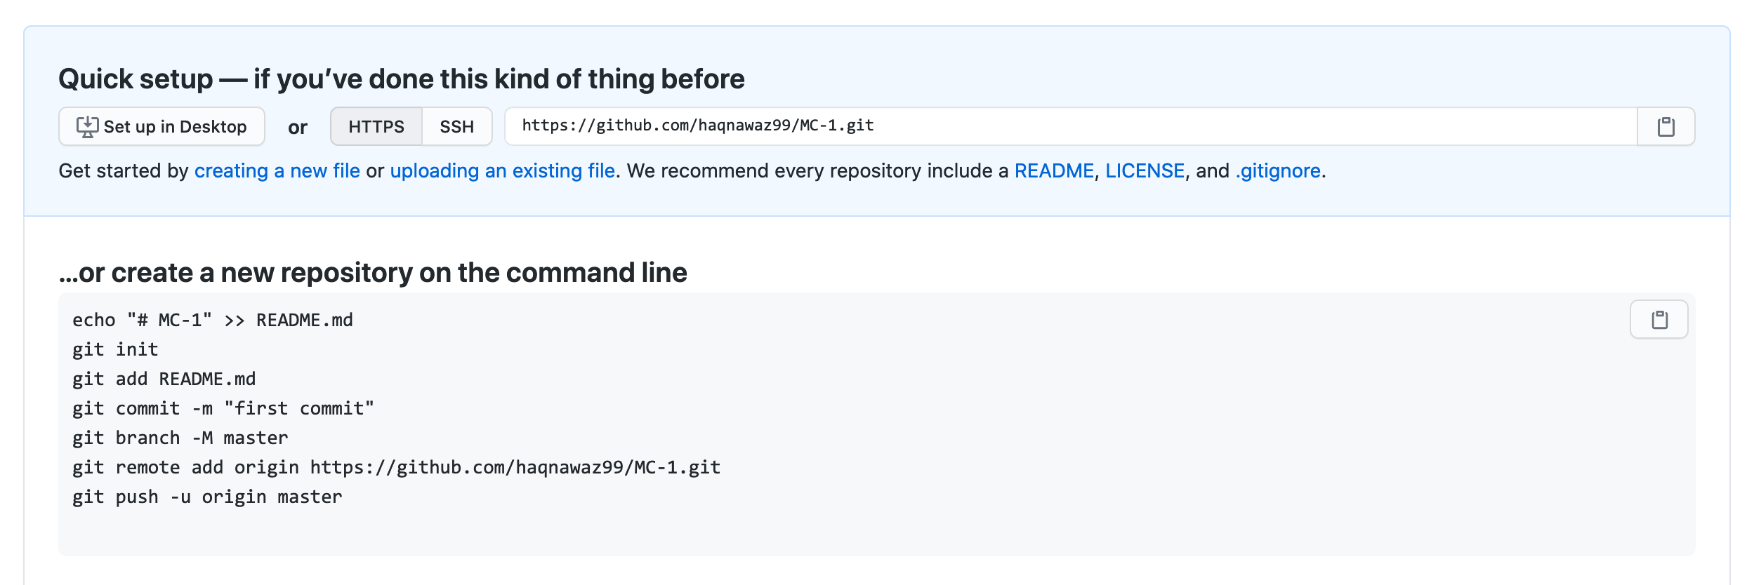
Mobile Computing
GitHub Repository
url of repository on your account

Slide 26
Mobile Computing
Git Clone
Clone a repository
code1
code2
code3
code4
git clone [url]
code1
code2
code3
code4

Slide 27
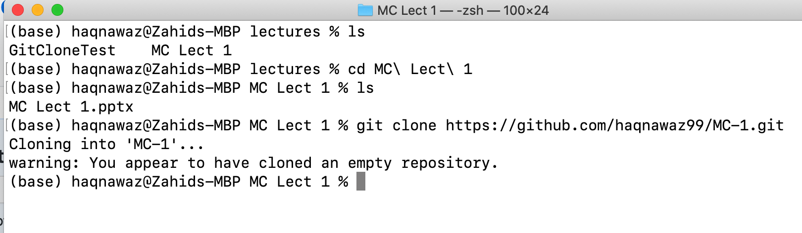
Mobile Computing
Git Clone
Clone a repository
git clone https://github.com/haqnawaz99/MC-1.git

Slide 28
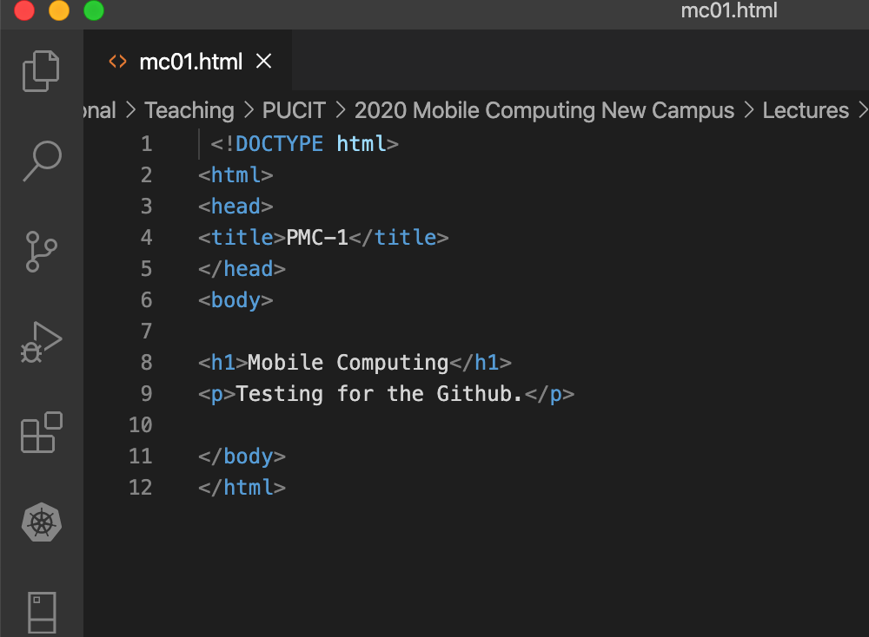
Mobile Computing
File Content
Created simple html file at local repository

Slide 29
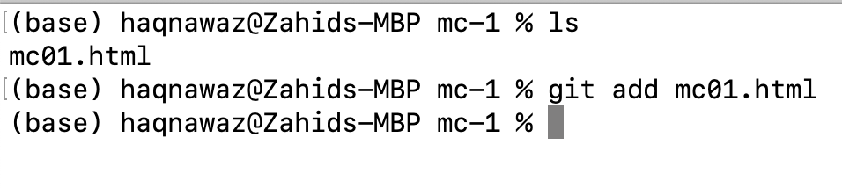
Mobile Computing
Git Add
Adding file to repository
git add File Name
git add mc01.html

Slide 30
Mobile Computing
Git Commit
Changes made with message to track changes
git commit -m “Message ”
git commit -m “First Commit ”

Slide 31
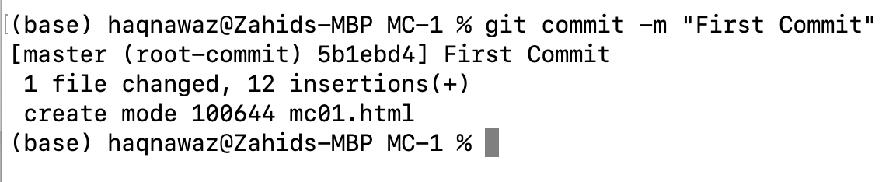
Mobile Computing
Git Commit
Changes made with message to track changes

Slide 32
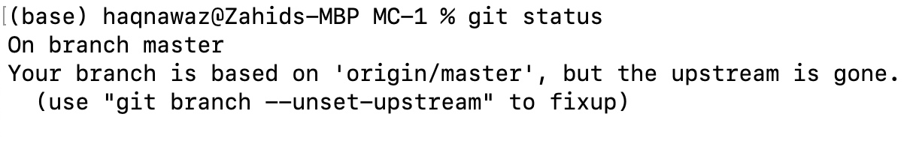
Mobile Computing
Git Status
Tells about the status of the repository
git status

Slide 33
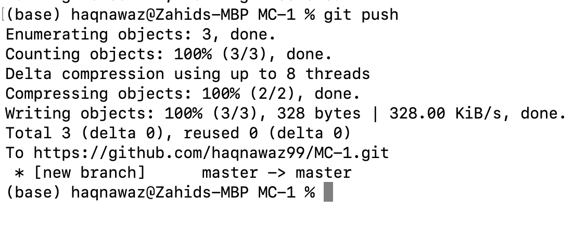
Mobile Computing
Git Push
Push changes to the server
git push

Slide 34
Mobile Computing
GitHub Repository
url of repository on your account

Slide 35
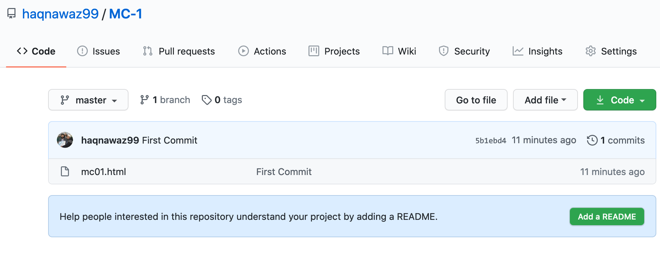
Mobile Computing
GitHub Repository
view of repository after push

Slide 36
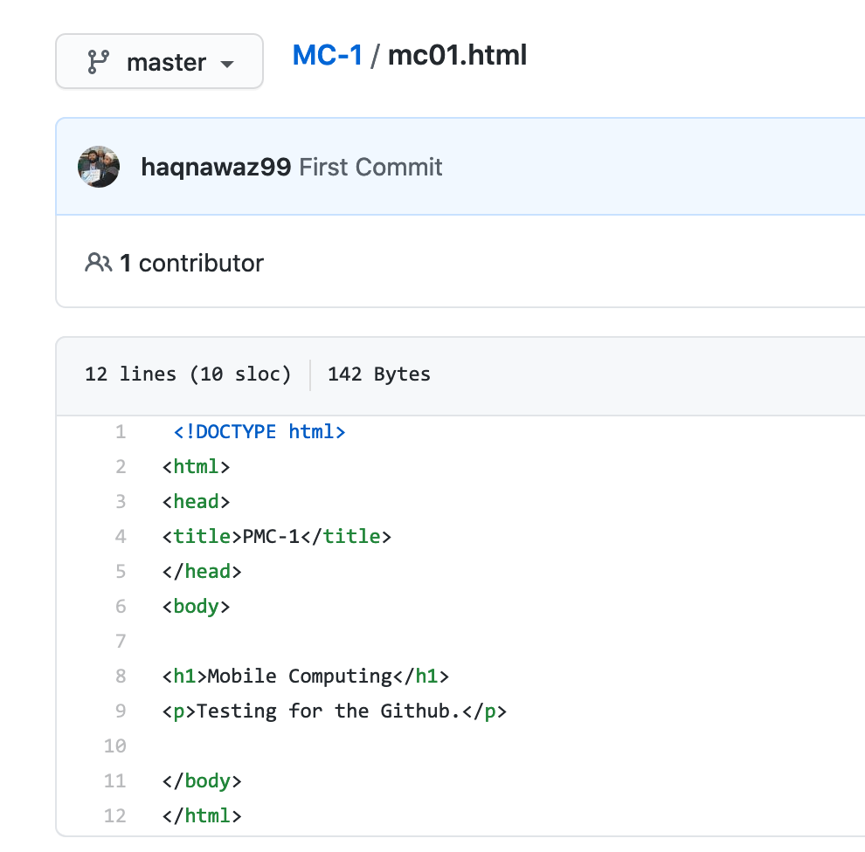
Mobile Computing
GitHub Repository
content of file in repository

Slide 37
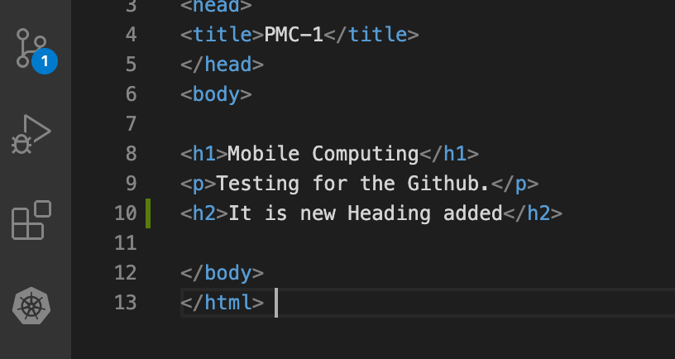
Mobile Computing
File Content
changes made at local repository

Slide 38
Mobile Computing
Adding new commit
Committing changes to repository
git add mc01.html
git commit –m ”Heading 2 added ”
git push

Slide 39
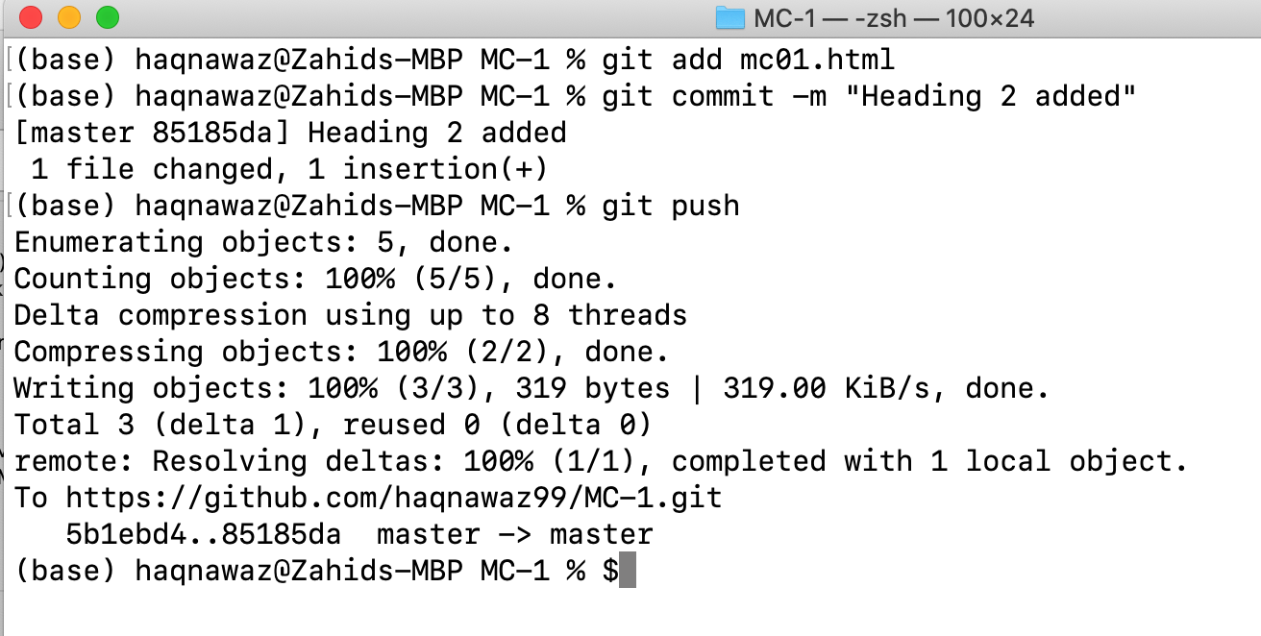
Mobile Computing
Adding new commit
Committing changes to repository

Slide 40
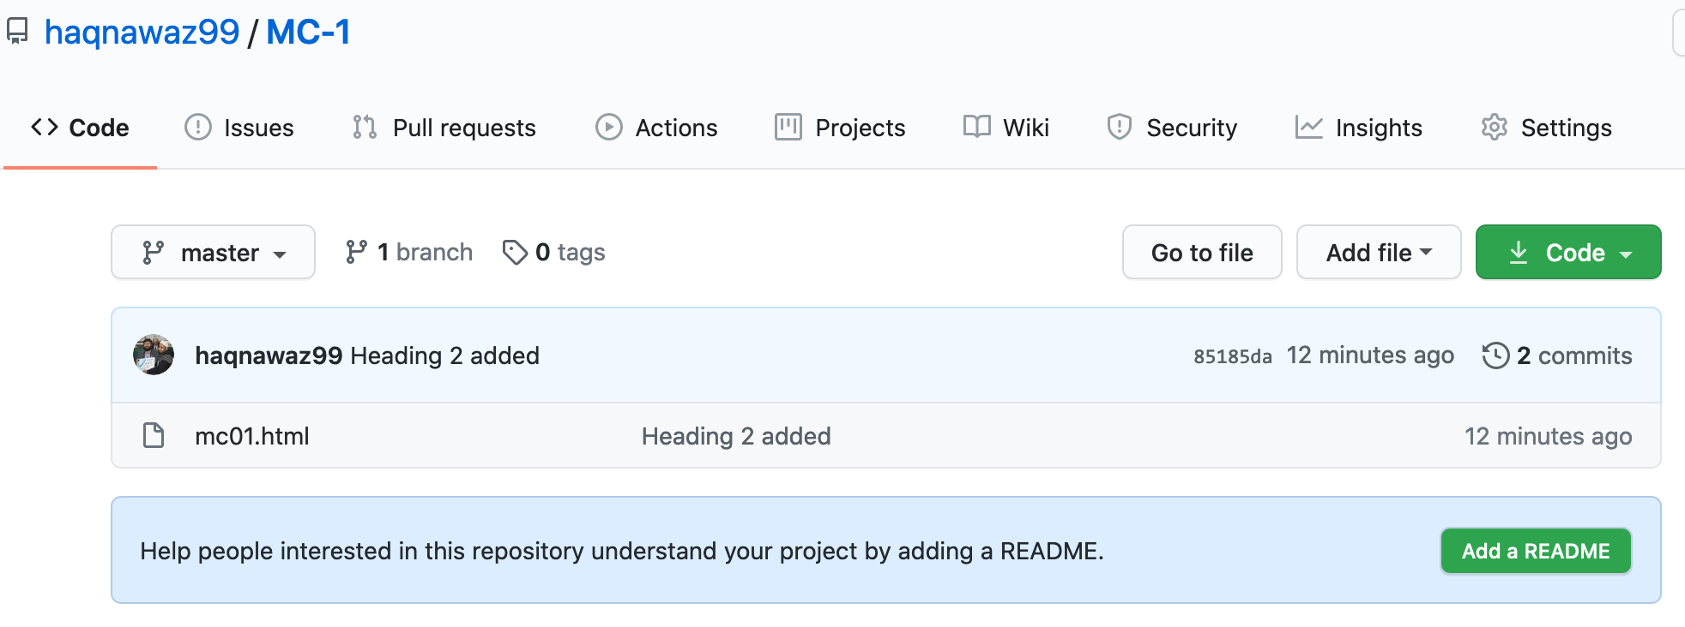
Mobile Computing
GitHub Repository
view of repository after second push

Slide 41
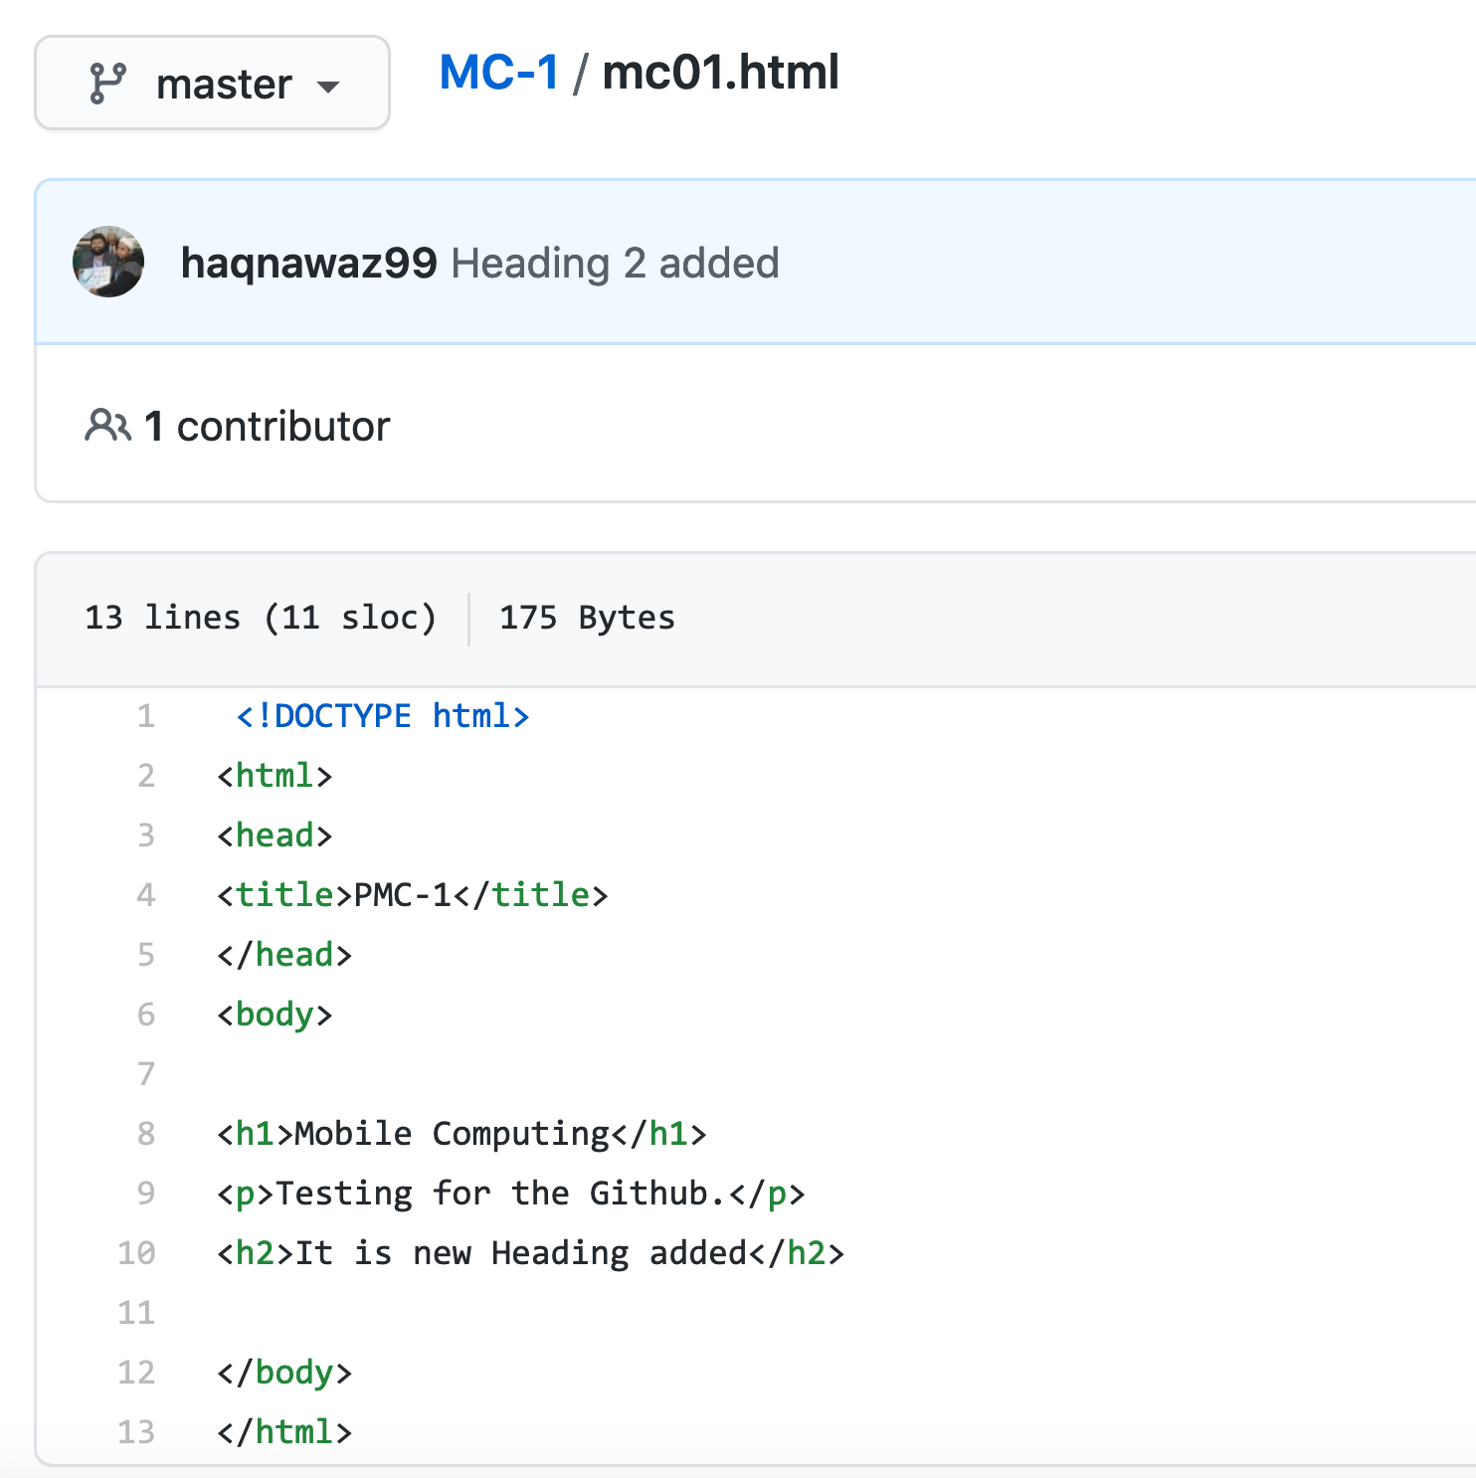
Mobile Computing
GitHub Repository
Track of changes

Slide 42
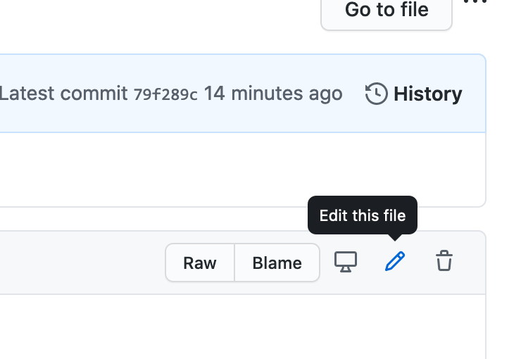
Mobile Computing
Edit Online
How to edit files at repository

Slide 43
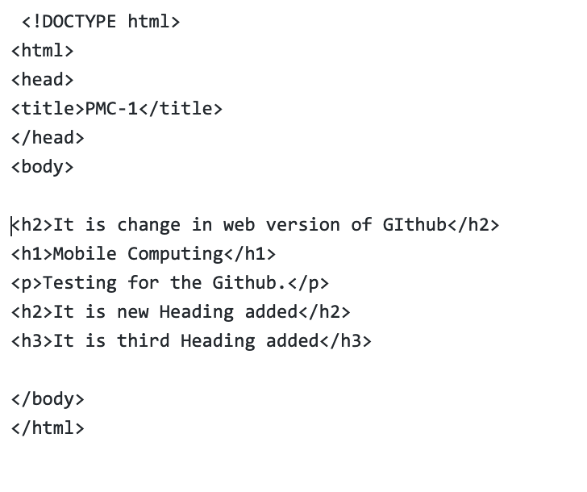
Mobile Computing
Edit Online
How to edit files at repository

Slide 44
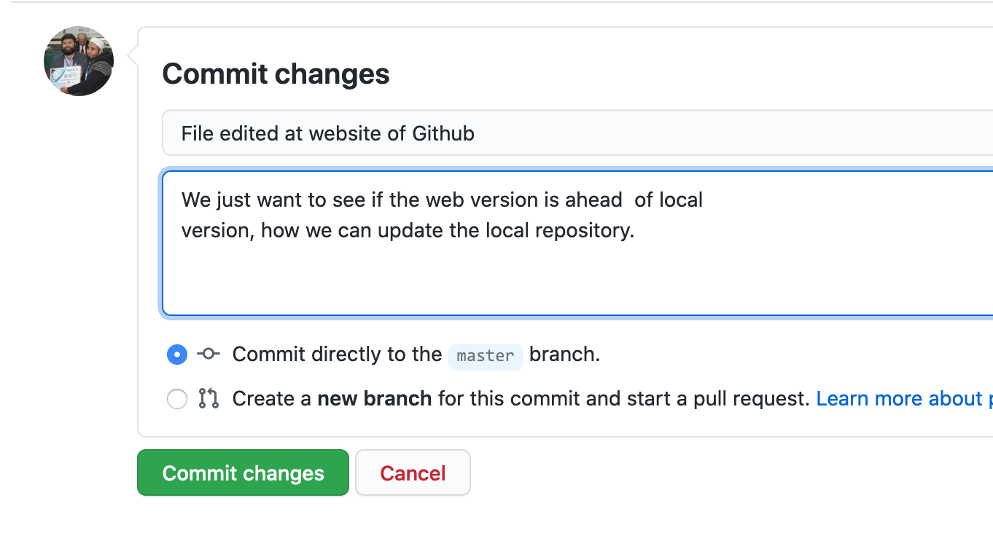
Mobile Computing
Commit changes at Web
How Commit at repository

Slide 45
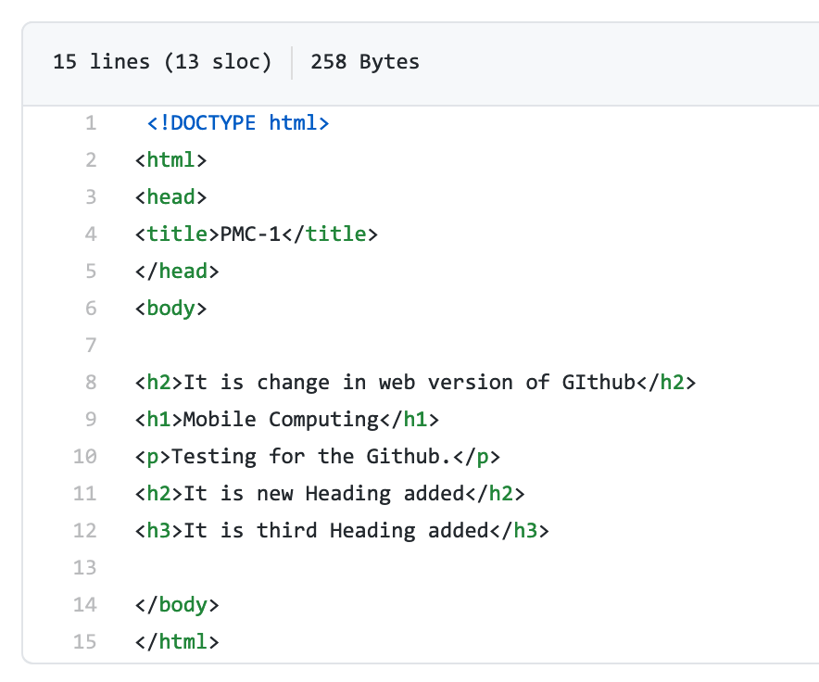
Mobile Computing
View changes
To view changes made online repository

Slide 46
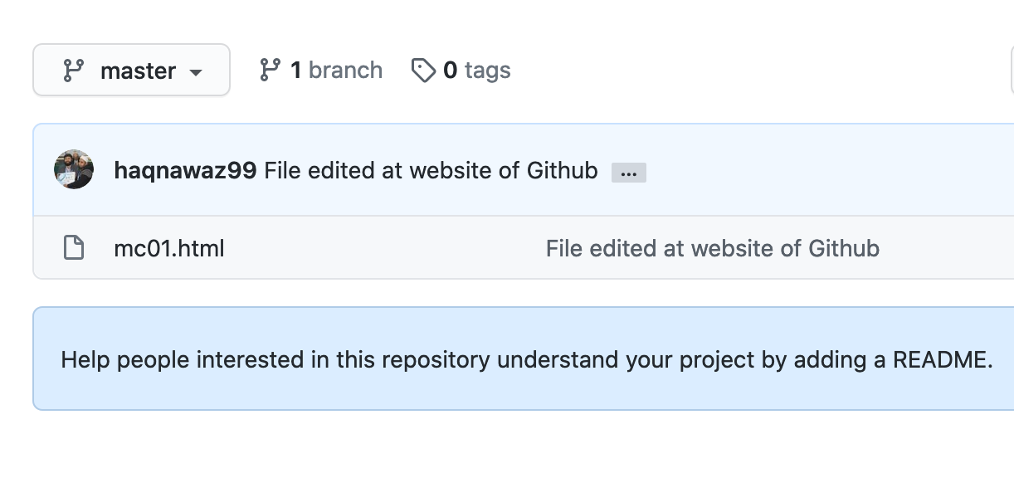
Mobile Computing
Version Hierarchy
File showing with latest commit

Slide 47
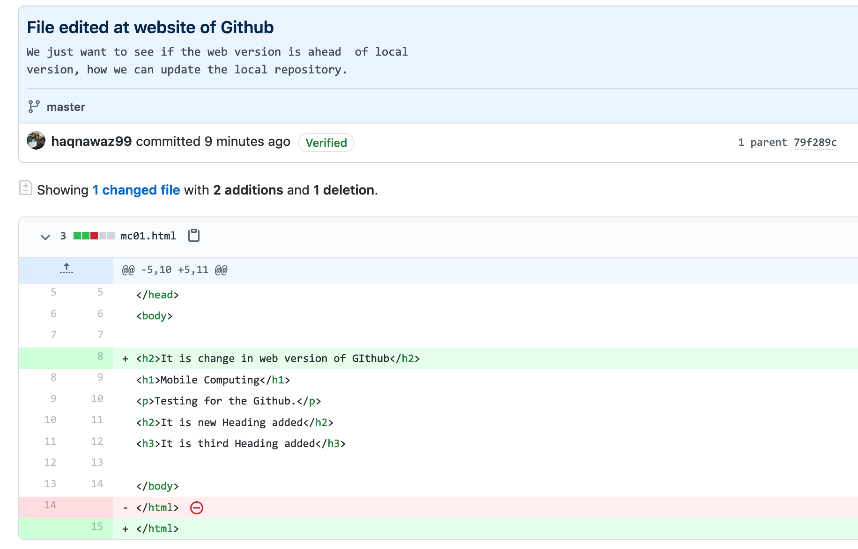
Mobile Computing
Version Hierarchy
File showing with latest commit

Slide 48
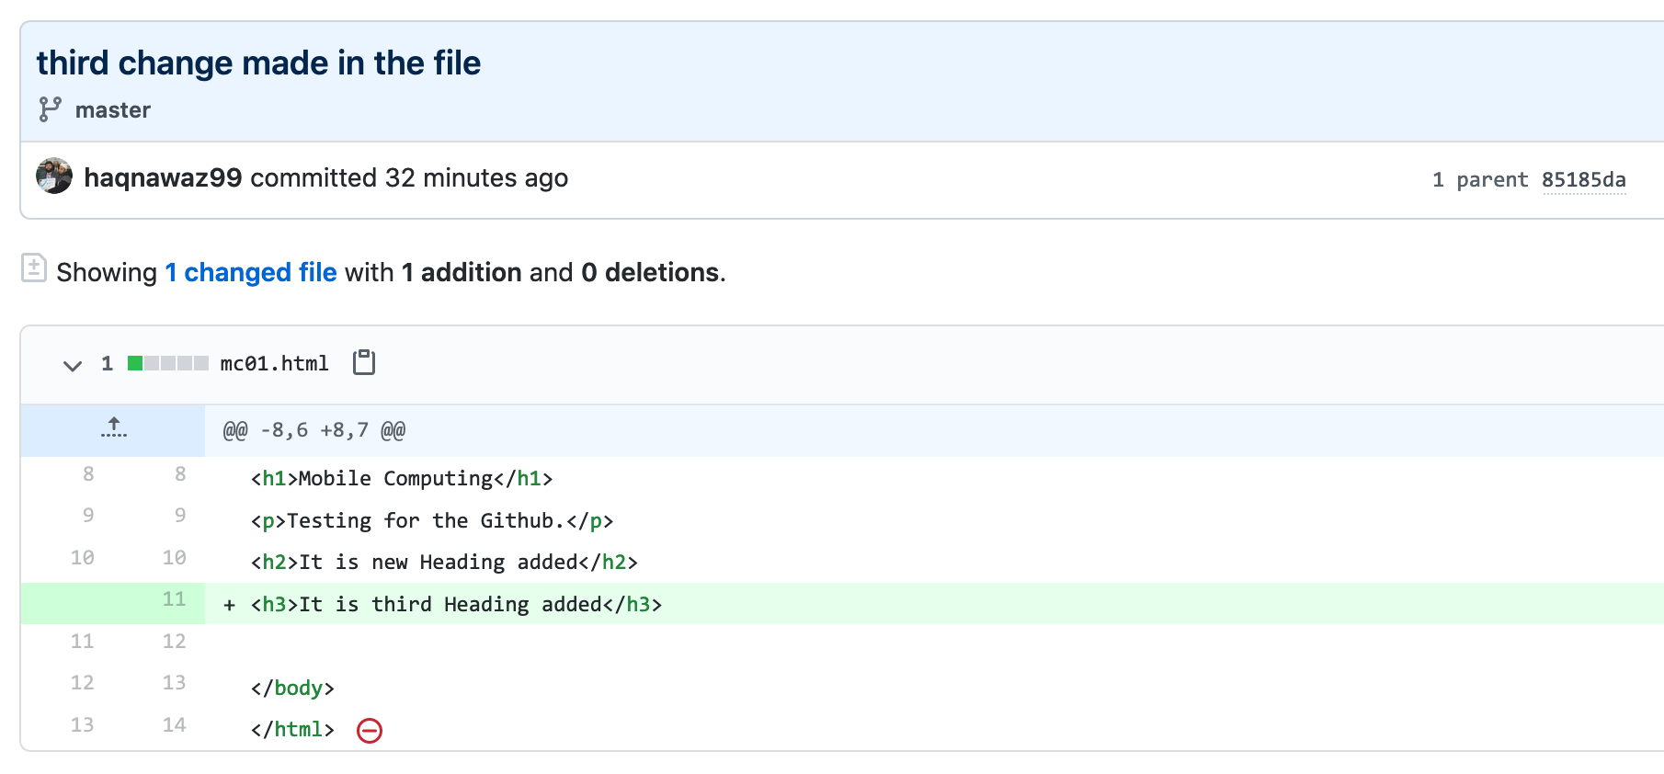
Mobile Computing
Version Hierarchy
File showing with latest commit

Slide 49
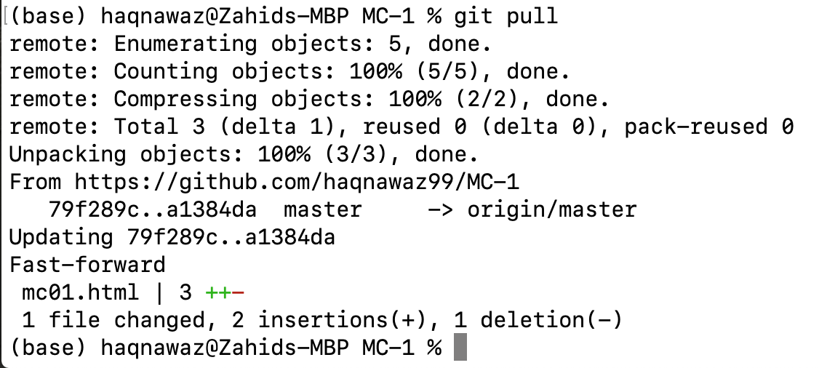
Mobile Computing
Git pull
To get changes from Github to local repository

Slide 50
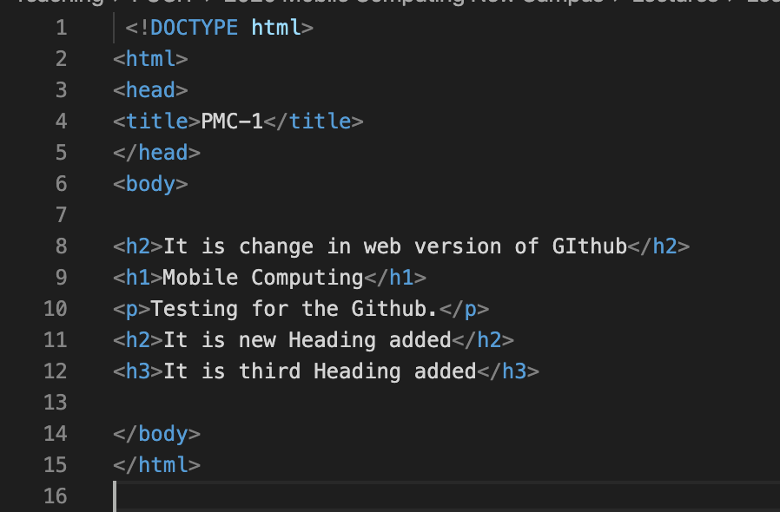
Mobile Computing
Git pull
To get changes from Github to local repository

Slide 51
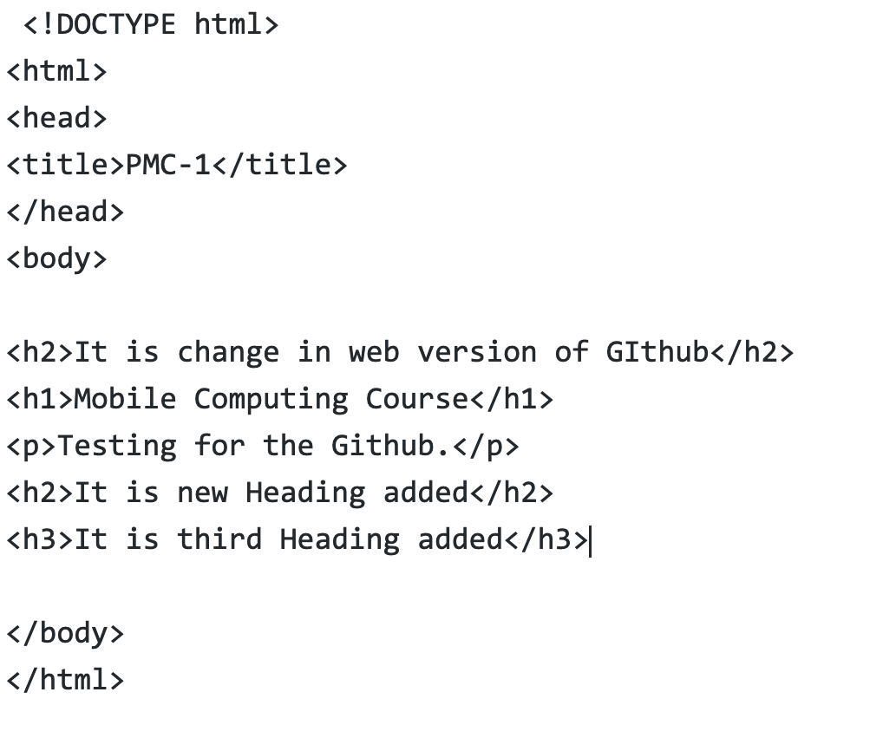
Mobile Computing
Merge Conflicts
File changed at github.com

Slide 52
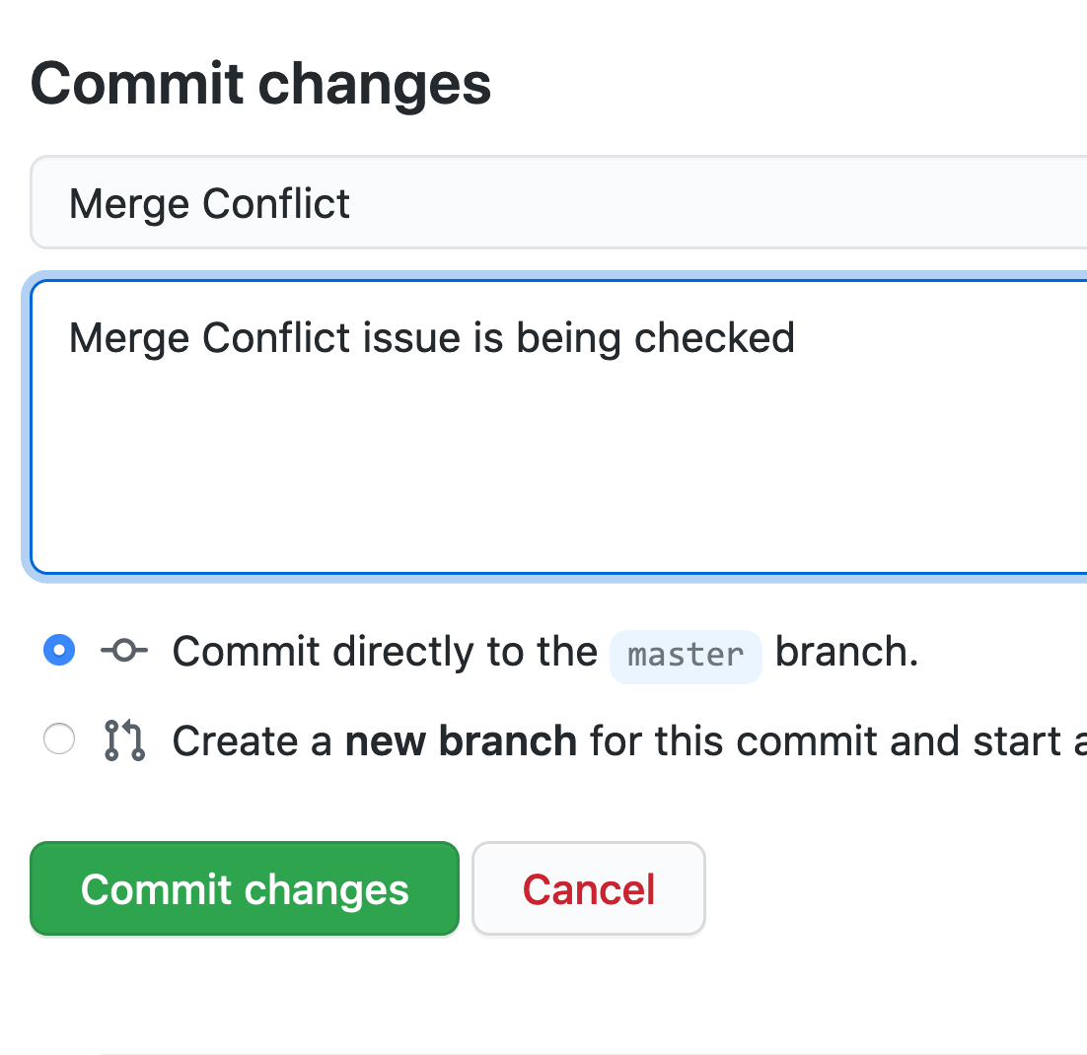
Mobile Computing
Merge Conflicts
New commit added

Slide 53
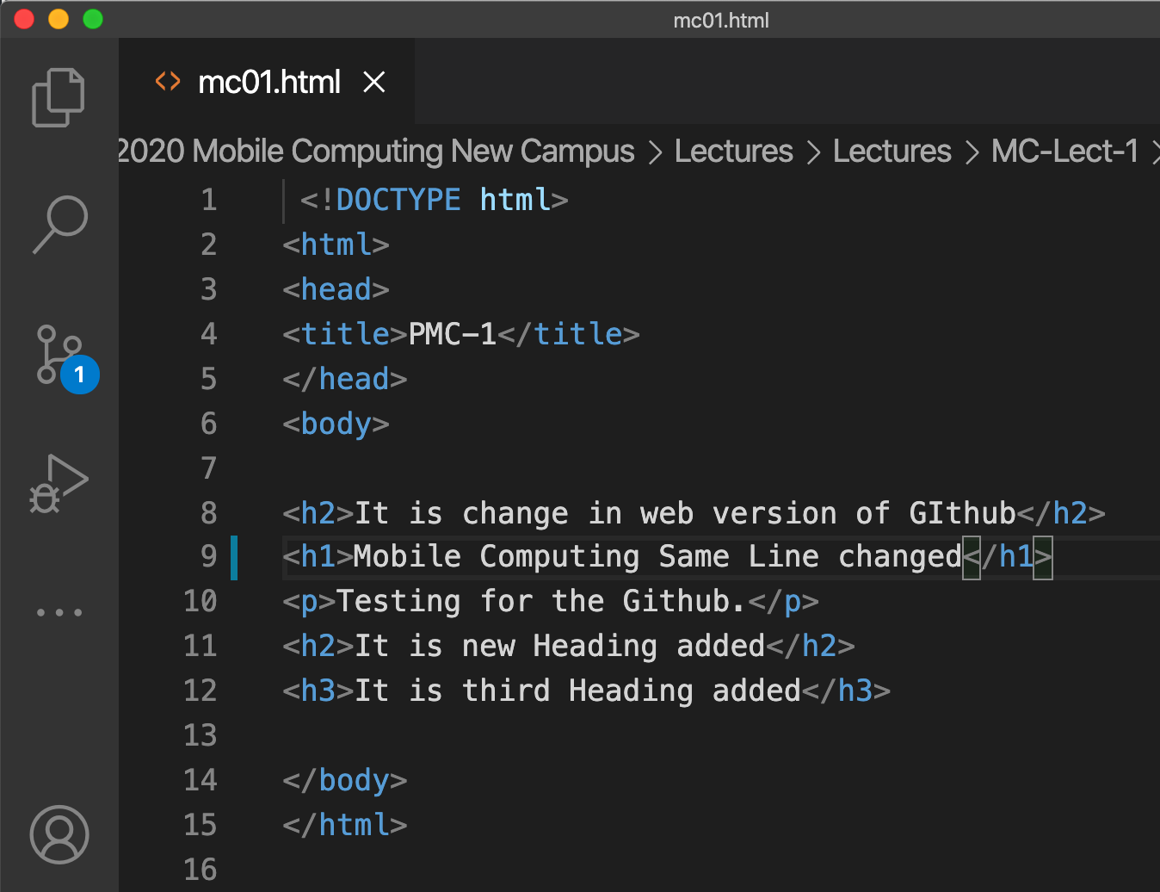
Mobile Computing
Merge Conflicts
Same line changed at local repository

Slide 54
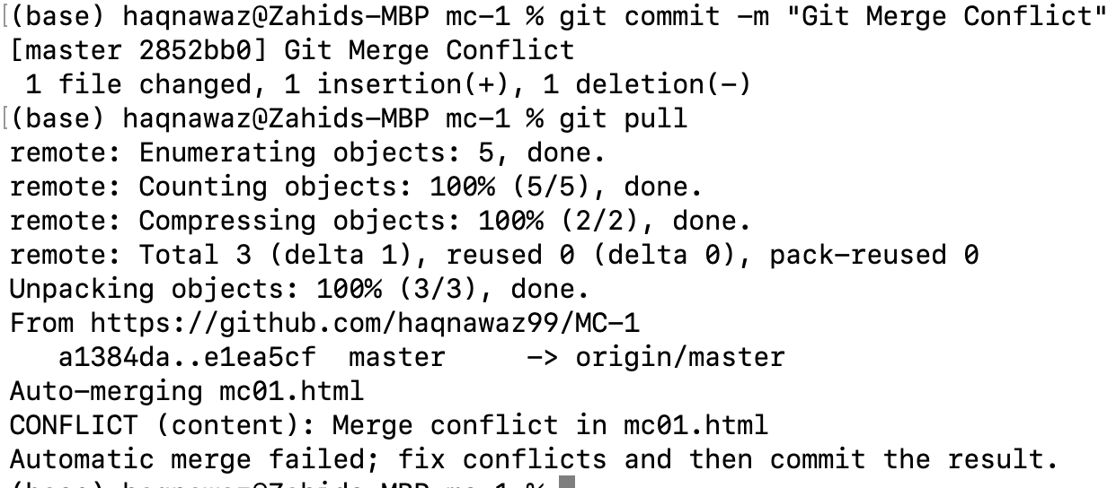
Mobile Computing
Merge Conflicts
Git add and commit

Slide 55
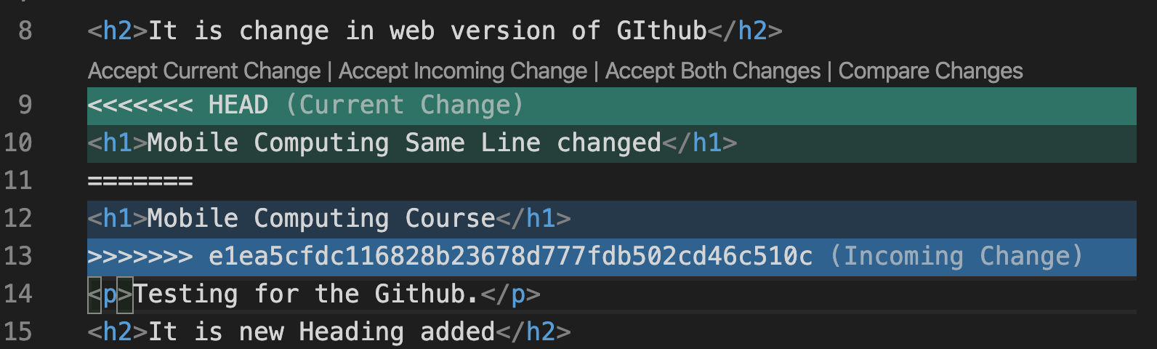
Mobile Computing
Merge Conflicts
New commit added

Slide 56
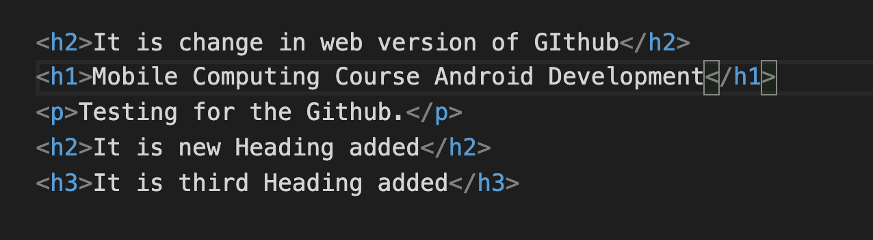
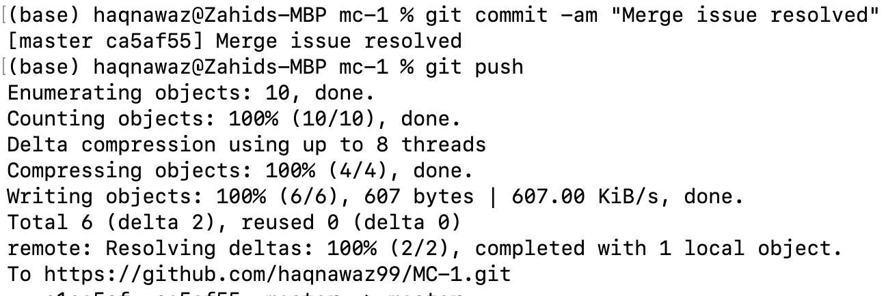
Mobile Computing
Merge Conflicts
Resolved Merge Conflicts

Slide 57
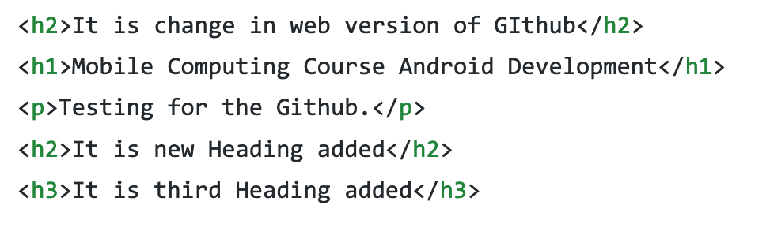
Mobile Computing
Merge Conflicts
Same data at github.com

Slide 58
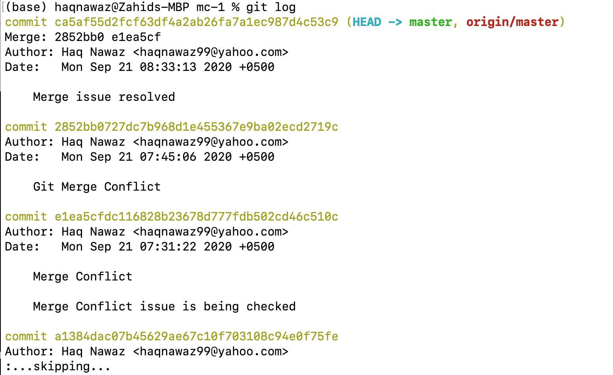
Mobile Computing
Git log
Details of commits

Slide 59
Mobile Computing
Branching
Create a Branch
When you're working on a project, you're going to have a bunch of different features or ideas in progress at any given time – some of which are ready to go, and others which are not. Branching exists to help you manage this workflow.
When you create a branch in your project, you're creating an environment where you can try out new ideas. Changes you make on a branch don't affect the main branch, so you're free to experiment and commit changes, safe in the knowledge that your branch won't be merged until it's ready to be reviewed by someone you're collaborating with.

Slide 60
Mobile Computing
Branching
Working with branches
New
Addition
Merge
First
Second
Third

Slide 61
Mobile Computing
Branching
Create a Branch
git branch
git check
git merge

Slide 62
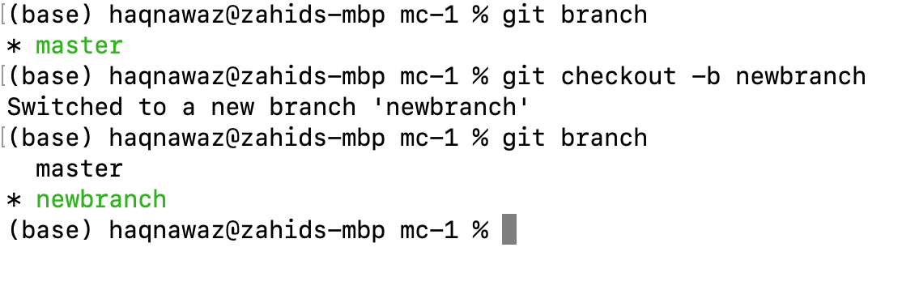
Mobile Computing
Branching
Create a Branch

Slide 63
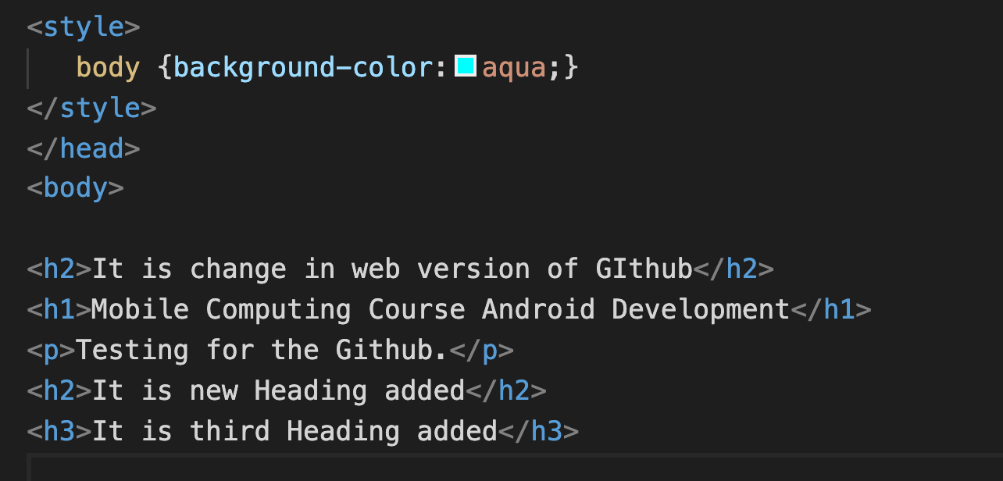
Mobile Computing
Branching
Create a Branch

Slide 64
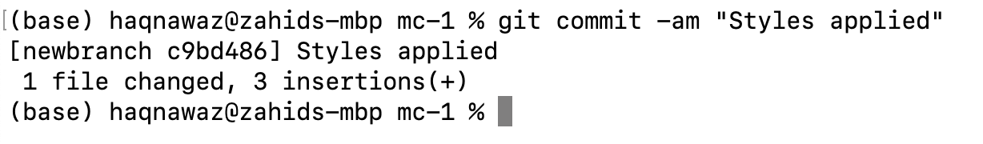
Mobile Computing
Branching
Commit Added

Slide 65
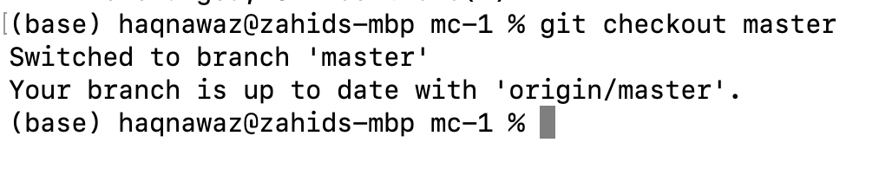
Mobile Computing
Branching
Switch to Master Branch

Slide 66
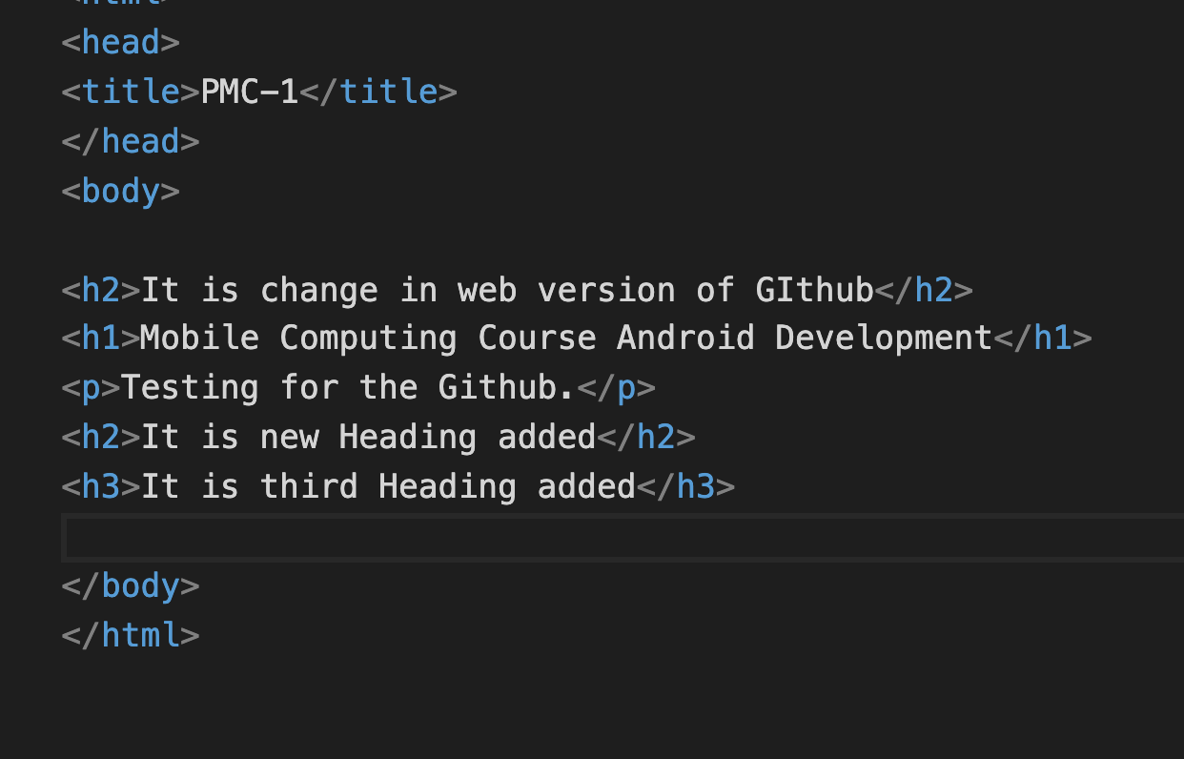
Mobile Computing
Branching
Master Branch

Slide 67
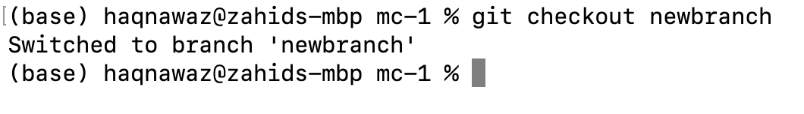
Mobile Computing
Branching
Switch to Newbranch Branch

Slide 68
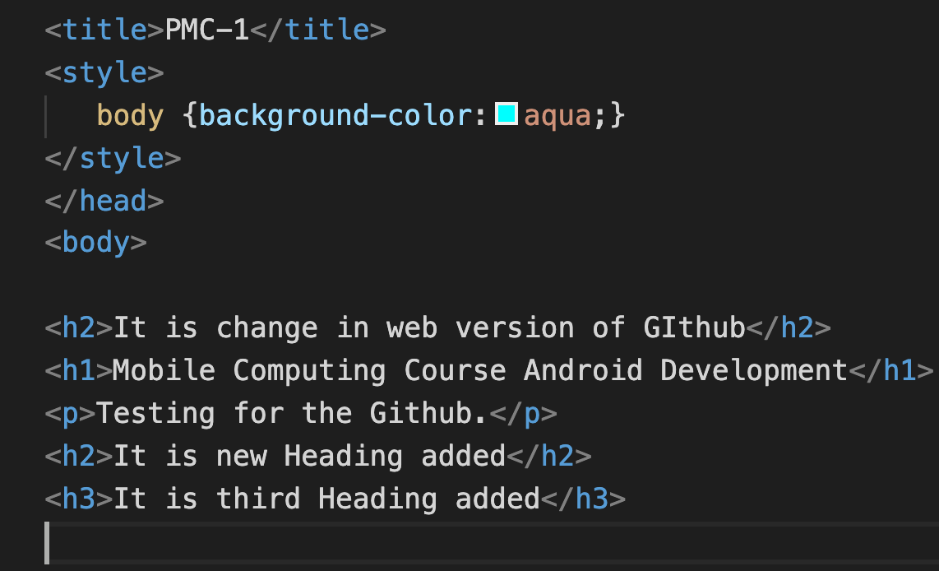
Mobile Computing
Branching
Newbranch Branch

Slide 69
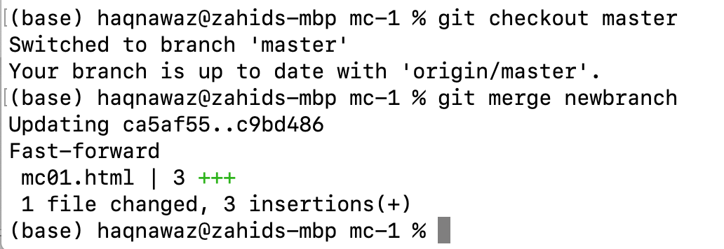
Mobile Computing
Merge
Merge different branches

Slide 70
Mobile Computing
Branching
Main Branch

Slide 71
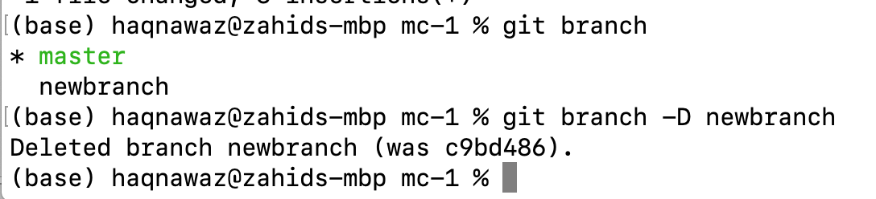
Mobile Computing
Delete Branch
Main Branch

Slide 72
Mobile Computing
Mobile Computing
Use of computer on the move
Compute a computational problem
Movement of work process from usual fixed position to a more dynamic position
Mobile Computing is when a work process is carried out somewhere where it was not previously possible
Transmission of Data, voice, video reception, transmission and processing anywhere and anytime.
Mobile Computing is an umbrella term used to describe technologies that enable people to access services anytime and anywhere

Slide 73
Mobile Computing
Goal of Mobile Computing
People and their machines should be able to access information and communicate with each other easily and securely, in any medium or combination of media – voice, data, image, video, or multimedia – any time, anywhere, in a timely, cost-effective way
any time?
Anywhere?
cost-effective way?

Slide 74
Mobile Computing
Why Mobile?
Enable anywhere/anytime connectivity
Bring computer communications to areas without pre-existing infrastructure
Enable mobility
Enable new applications
An exciting new research area

Slide 75
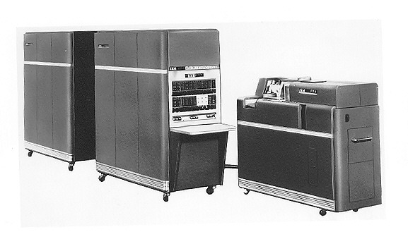
Mobile Computing
Evolution - Portability

Slide 76
Mobile Computing
Evolution - Miniaturization

Slide 77

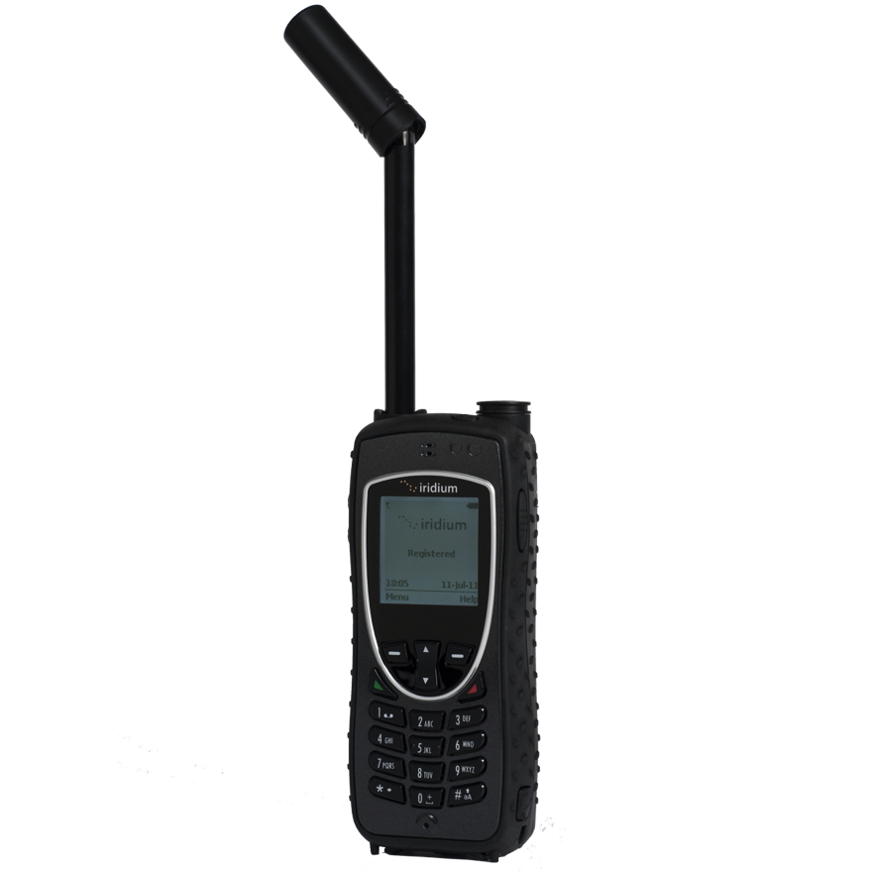


Mobile Computing
Evolution - Connectivity
Developing devices and applications that allowed users to be online and communicate via wireless data networks while on the move

Slide 78
Mobile Computing
Evolution - Convergence

Slide 79
Mobile Computing
Evolution - Digital Ecosystems

Slide 80
Mobile Computing
Example: Smartphone
Portability: carry it anywhere you want
Miniaturization: make it possible to build device to fit in your pocket
Connectivity: Wi-Fi, LTE/4G, cellular, Bluetooth
Convergence: phone, camera, gaming device, video streaming, audio player, reading …
Applications: “Rise of the Apps”
Digital Ecosystem: social networks, distributed gaming, video streaming, work apps, …

Slide 81
Mobile Computing
Smartphone Sale

Slide 82
Mobile Computing
Digital Health Trends

Slide 83
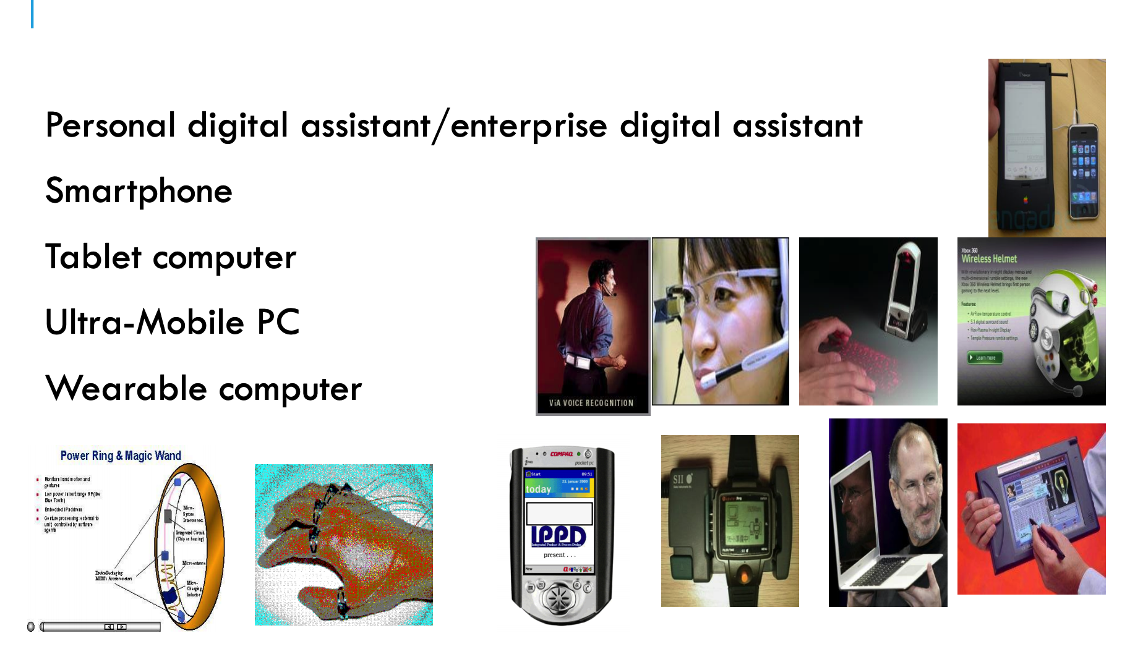
Mobile Computing
MOBILE COMPUTING DEVICES

Slide 84
Mobile Computing
MOBILE COMPUTING LIMITATIONS
Range & Bandwidth: Mobile Internet access is generally slower than direct cable connections,
Security standards: When working mobile, one is dependent on public networks.
Power consumption: rely entirely on battery power Transmission interferences: Weather, and the range from the nearest signal point can all interfere with signal reception. Potential health hazards: more likely to be involved in traffic accidents.
Human interface with device: Screens and keyboards tend to be small, which may make them hard to use.

Slide 85
Android Architecture

Slide 86
Android Architecture
Application Framework
The application framework is used most often by application developers. As a hardware developer, you should be aware of developer APIs as many map directly to the underlying HAL (Hardware Abstraction Layer) interfaces and can provide helpful information about implementing drivers.

Slide 87
Android Architecture
Binder IPC
The Binder Inter-Process Communication (IPC) mechanism allows the application framework to cross process boundaries and call into the Android system services code. This enables high level framework APIs to interact with Android system services. At the application framework level, this communication is hidden from the developer and things appear to "just work".

Slide 88
Android Architecture
System services
System services are modular, focused components such as Window Manager, Search Service, or Notification Manager. Functionality exposed by application framework APIs communicates with system services to access the underlying hardware. Android includes two groups of services: system (such as Window Manager and Notification Manager) and media (services involved in playing and recording media).

Slide 89
Android Architecture
HAL
A HAL (Hardware abstraction layer) defines a standard interface for hardware vendors to implement, which enables Android to be agnostic about lower-level driver implementations. Using a HAL allows you to implement functionality without affecting or modifying the higher level system. HAL implementations are packaged into modules and loaded by the Android system at the appropriate time

Slide 90
Android Architecture
Linux Kernel
Developing your device drivers is similar to developing a typical Linux device driver. Android uses a version of the Linux kernel with a few special additions such as Low Memory Killer (a memory management system that is more aggressive in preserving memory), wake locks (a PowerManager system service), the Binder IPC driver, and other features important for a mobile embedded platform. These additions are primarily for system functionality and do not affect driver development. You can use any version of the kernel as long as it supports the required features (such as the binder driver). However, we recommend using the latest version of the Android kernel

